Slide 1
Forecasting housing costs up to 2027
Evaluating historical and future housing prices in Minnesota, Wisconsin, Illinois, Indiana and Michigan

Slide 2
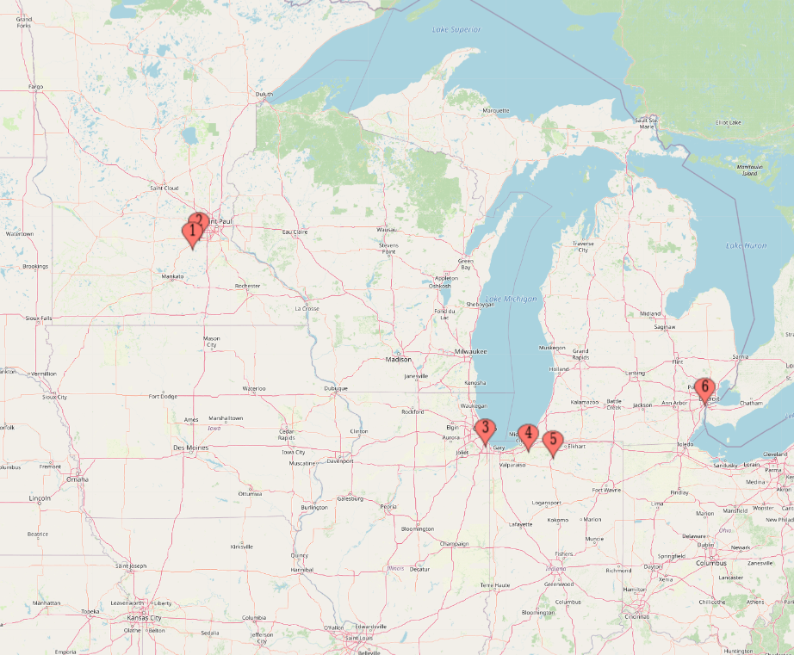
Understanding the Problem
My fiance and I will not be looking to purchase a house until 2026-27
We will be price conscious buyers
We have family distributed throughout several Midwest states

Slide 3

Data
Zillow - online real estate marketplace
Publishes a variety of data online - https://www.zillow.com/research/data/

Slide 4
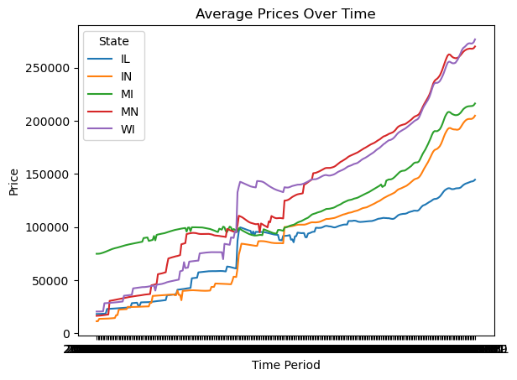
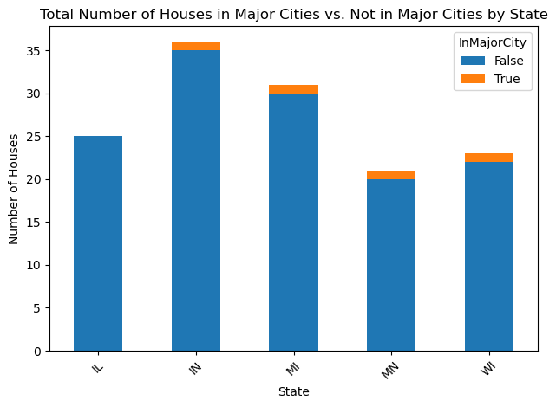
Exploratory Data Analysis
Surprising initial results

Slide 5
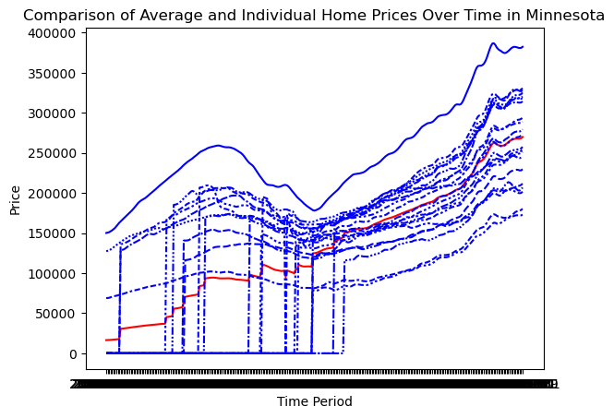
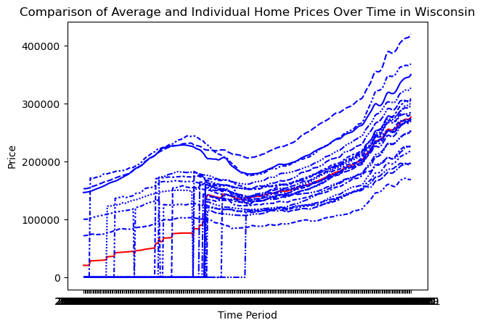
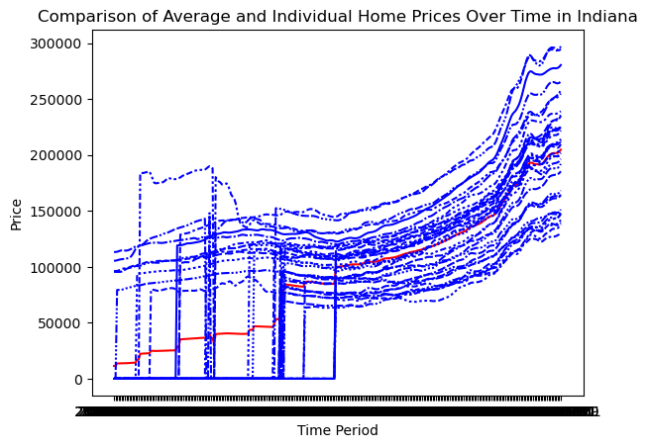
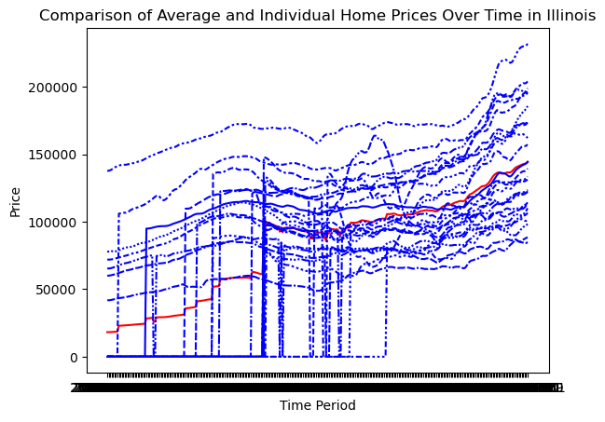
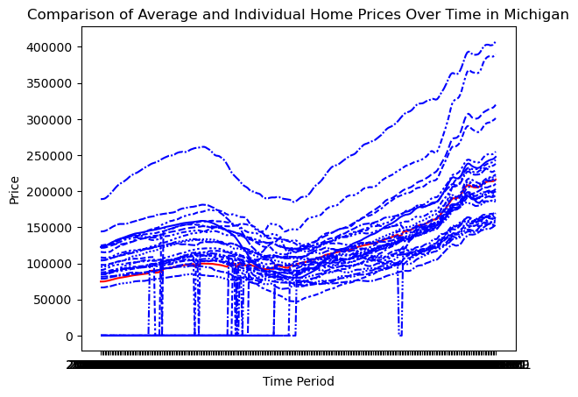
Exploratory Data Analysis - Cont’d

Slide 6
Notable Data Features
Illinois appears to be the cheapest state
There appear to be groupings of state values
Prices have been consistently increasing since 2012
There does not appear to be a “metro bias” in statewide pricing

Slide 7
Model Selection
Our data is already in scale
All relevant data is continuous, not categorical
Initial models considered included Linear Regression, Decision Tree Regressor, and Random Forest Regressor, and Meta’s Prophet model for time series forecasts

Slide 8
Model Performance
Model metric will be MSE
Linear Regression MSE: 944,302,385.64
Random Forest Regressor MSE: 1,320,461,709.98
Decision Tree Regressor MSE: 1,255,531,559.25
Prophet MSE: 76,557,561.83

Slide 9
Modeling
We iterate through each state, modeling the years 2024-2027 utilizing Prophet
Growth = linear (the pattern we see in historical data is roughly linear, not logarithmic)
Changepoint_prior_scale = 1.5 (Allows for some flexibility in automatically finding changepoints - further flexibility was found to hurt MSE)
Changepoint_range = 1 (allows for full usage of historical data in generating its forecasts)
We create an empty dataframe in which to place our new predictions for modelling

Slide 10
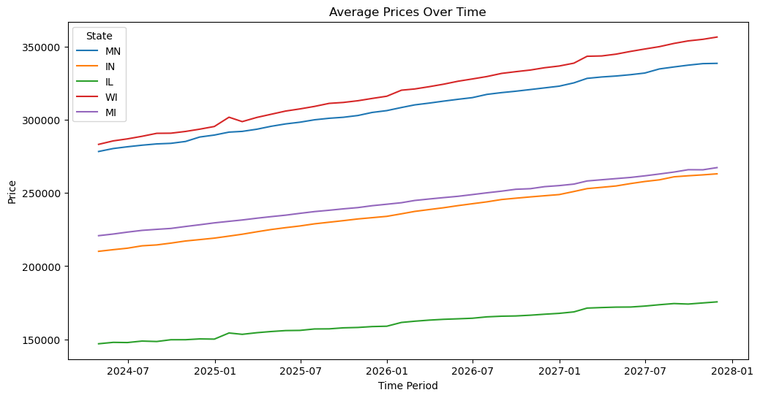
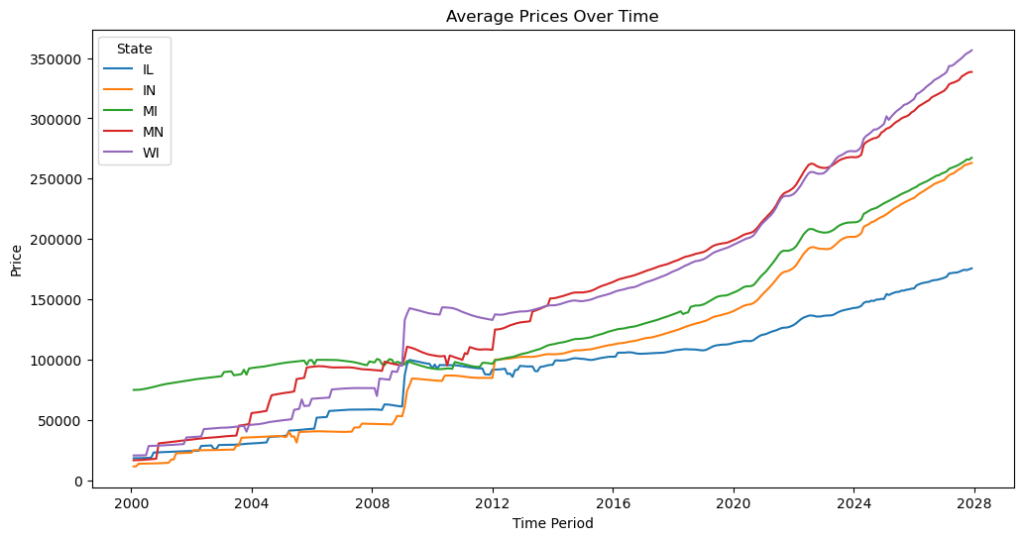
Results

Slide 11
Insights and Conclusion
Illinois will remain the least expensive state to purchase a home through 2027
States will continue the intriguing pattern of separating into segments, tied closely together in housing costs
Minnesota (our current home) and Wisconsin will continue at a near-identical pace to remain the most expensive states, and the gap will continue to widen

Slide 12
Future Research
It may be interesting and useful to research the following:
How well do housing costs correlate with the overall cost of living in a state?
Are there specific similarities between Minnesota/Wisconsin and Michigan/Indiana that have caused their home values to tie so closely together?
Given the housing costs we have forecasted, is it reasonable to believe first time home buyers are likely to leave Minnesota and Wisconsin for more affordable states?

